Slide 1



WEEK 5 FINAL ASSIGNMENT
CST 499 Capstone for Computer Software Technology
STUDENT: JACOB HALPERIN
INSTRUCTOR: PROF. Joseph Rangitsch
MARCH 3RD, 2025

Slide 2
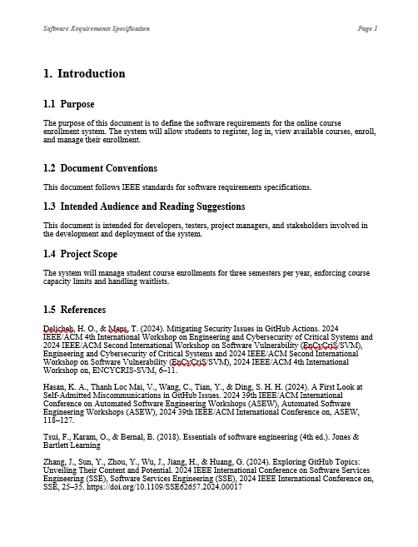
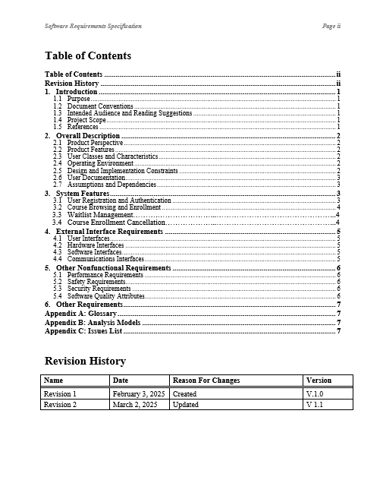
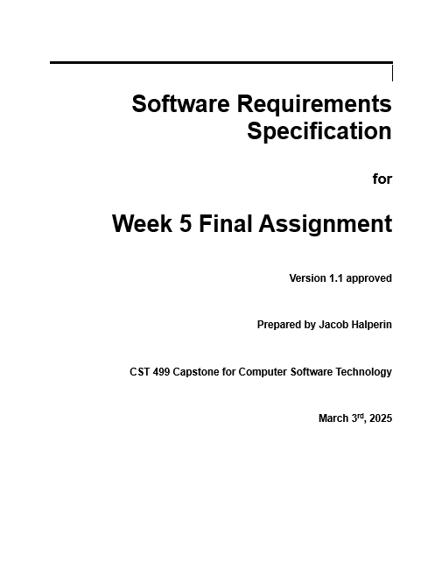
Software requirements specifications (SRS) Document
Definition and purpose of SRS: The Software Requirements Specification document is the formal description of the system's desired capabilities and behavior, required to align stakeholder expectations and direct the development process.
Major components of an SRS: An SRS would ideally include sections on functional requirements, non-functional requirements, use cases, and constraints, providing a total picture of what the software needs to perform.
Best practices to write SRS: To be clear and for complete understanding, adhere to methodologies such as using simple language, giving examples, and being consistent; validate requirements through reviews by stakeholders in order to make the document more accurate.

Slide 3
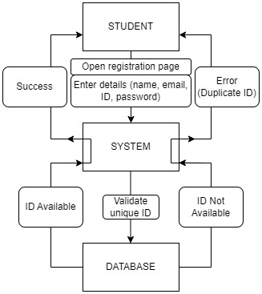
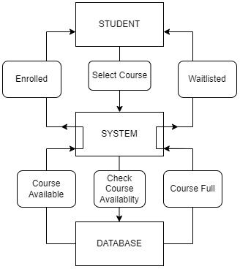
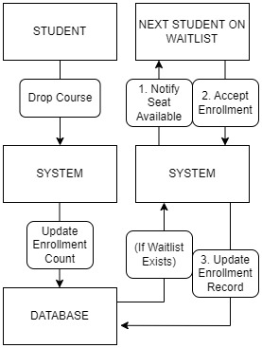
Uml design models
Student registration
Course enrollment
Dropping a course

Slide 4

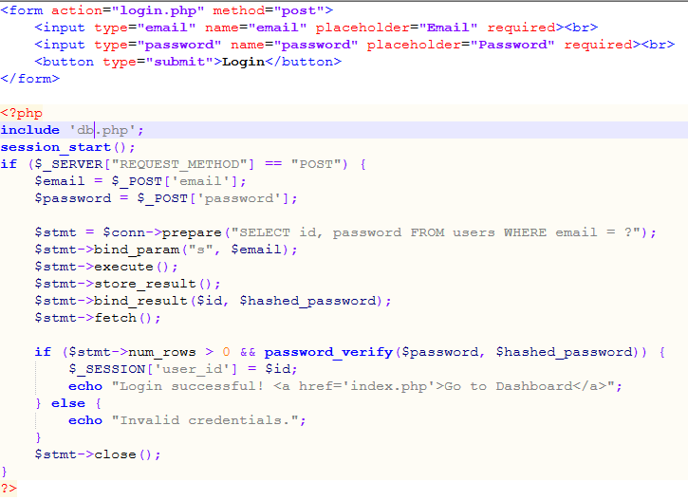
DESIGN OF THE LOGIN PAGE
LOGIN PAGE WITH CODE
DESCRIPTION AND FUNCTIONALITY
This page allows users to enter their credentials (username/email and password).
User authentication is handled by checking the credentials against the users table in the MySQL database.
If authentication is successful, a session is created for the user, and they are redirected to the landing page.
If authentication fails, an error message is displayed.

Slide 5
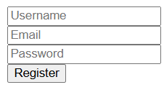
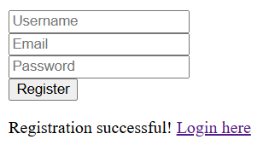
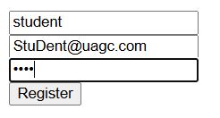
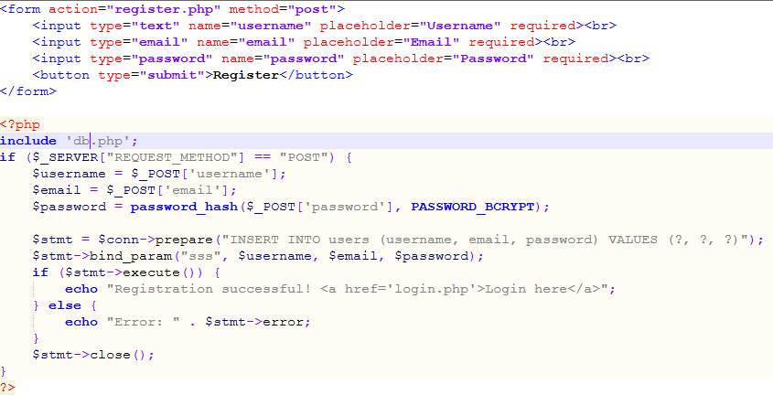
DESIGN OF the registration page
Registration page with code
DESCRIPTION AND FUNCTIONALITY
Users can create an account by providing a username, email, and password.
The password is securely hashed before being stored in the users table.
Upon successful registration, users can log in to access the system.

Slide 6
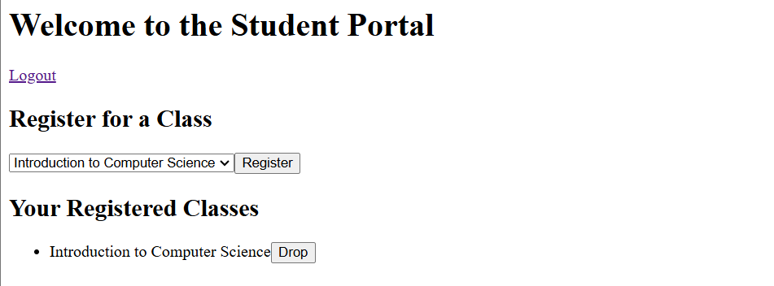
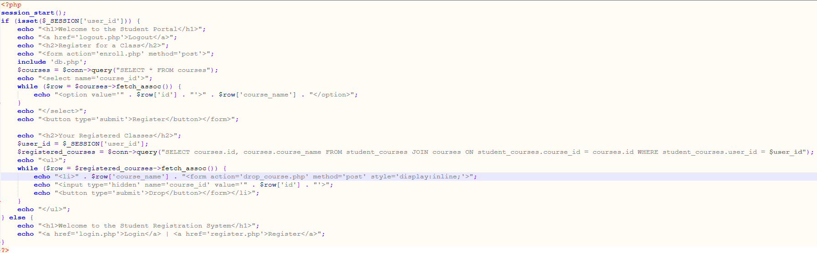
DESIGN OF THE LANDING PAGE
LANDING PAGE WITH CODE
DESCRIPTION AND FUNCTIONALITY
This page serves as the main entry point to the system.
If a user is logged in, they are welcomed and provided with options to:
View their registered courses.
Register for a new course.
Drop a course from their schedule.
Logout.
If a user is not logged in, they are given the option to log in or register.

Slide 7
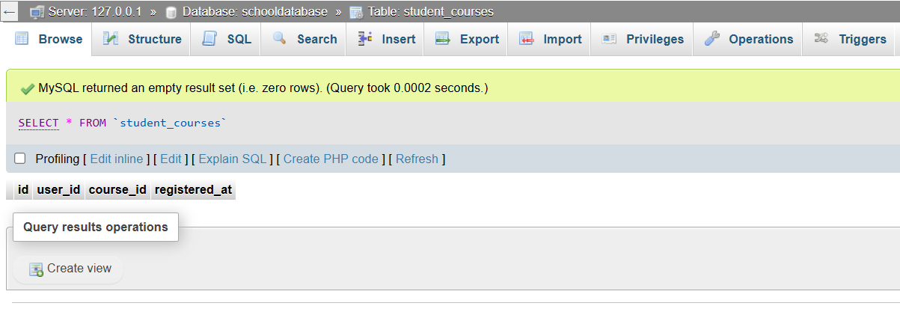
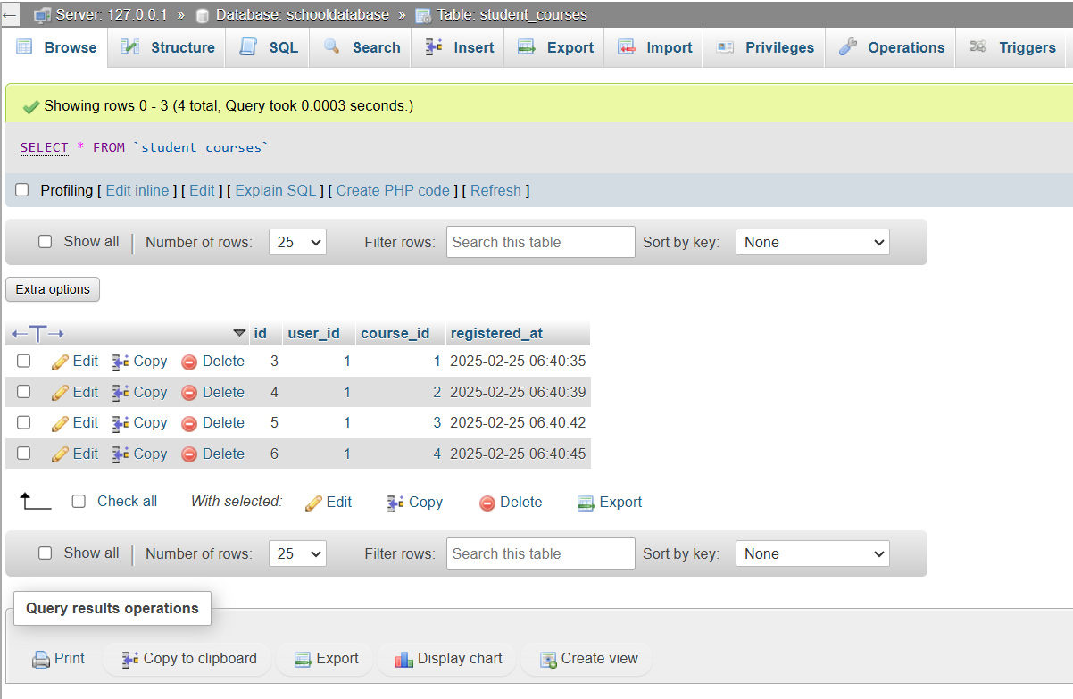
DESIGN OF THE enrollment (part 1)
Database table prior enrollment
DESCRIPTION AND FUNCTIONALITY
When a user enrolls in a class, their user_id and the selected course_id are stored in student_courses.
Dropping a course removes the entry from student_courses.
Establishes a connection to the MySQL database using mysqli.
Handles connection errors gracefully.
User Authentication (login.php)
Checks login credentials by querying the users table.
Uses PHP sessions to maintain user state.
Stores user information in the users table.
Uses password hashing for security.

Slide 8
DESIGN OF THE enrollment (part 2)
Database table prior enrollment
DESCRIPTION AND FUNCTIONALITY
Inserts a new record into student_courses linking the user to the course.
Prevents duplicate enrollments.
Queries student_courses and courses to display courses for the logged-in user.
Dropping Courses (drop_course.php)
Deletes the selected course from student_courses, removing the association.

Slide 9
references
Al-Fedaghi, S. (2021). Model Multiplicity (UML) Versus Model Singularity in System Requirements and Design. IJCSNS International Journal of Computer Science and Network Security, VOL.21 No.4, April 2021.
Darmawikarta, D., & Setiadi, M. (2014). SQL for MySQL : a beginner’s tutorial / Djoni Darmawikarta ; book and cover designer, Mona Setiadi. Brainy Software Inc.
Drusinsky, D., & ProQuest (Firm). (2006). Modeling and verification using UML statecharts [electronic resource] : a working guide to reactive system design, runtime monitoring, and execution-based model checking / Doron Drusinsky. Newnes.
Jena, D., Kumari, A., Titoria, J., Ankita, Rathee, N., & Kumar, B. (2023). Systematic Literature Review on Object Oriented Software Testing Techniques. 2023 International Conference on Innovative Data Communication Technologies and Application (ICIDCA), Innovative Data Communication Technologies and Application (ICIDCA), 2023 International Conference On, 327–333. https://doi.org/10.1109/ICIDCA56705.2023.10100236
Pettit, T. (2022). The MySQL workshop : a practical guide to working with data and managing databases with MySQL / Thomas Pettit and Scott Cosentino. Packt Publishing.
Sugiarti, Y., Maulana, M. C., Az-zahra, M., M Anwas, E. O., Permatasari, A. D., & Iftitah, K. N. (2024). The use of Software Testing Techniques in Software Development: Literature Review. 2024 12th International Conference on Cyber and IT Service Management (CITSM), Cyber and IT Service Management (CITSM), 2024 12th International Conference On, 1–5. https://doi.org/10.1109/CITSM64103.2024.10775739
Tsui, F., Karam, O., & Bernal, B. (2018). Essentials of software engineering (4th ed.). Jones & Bartlett Learning

